Slide 1
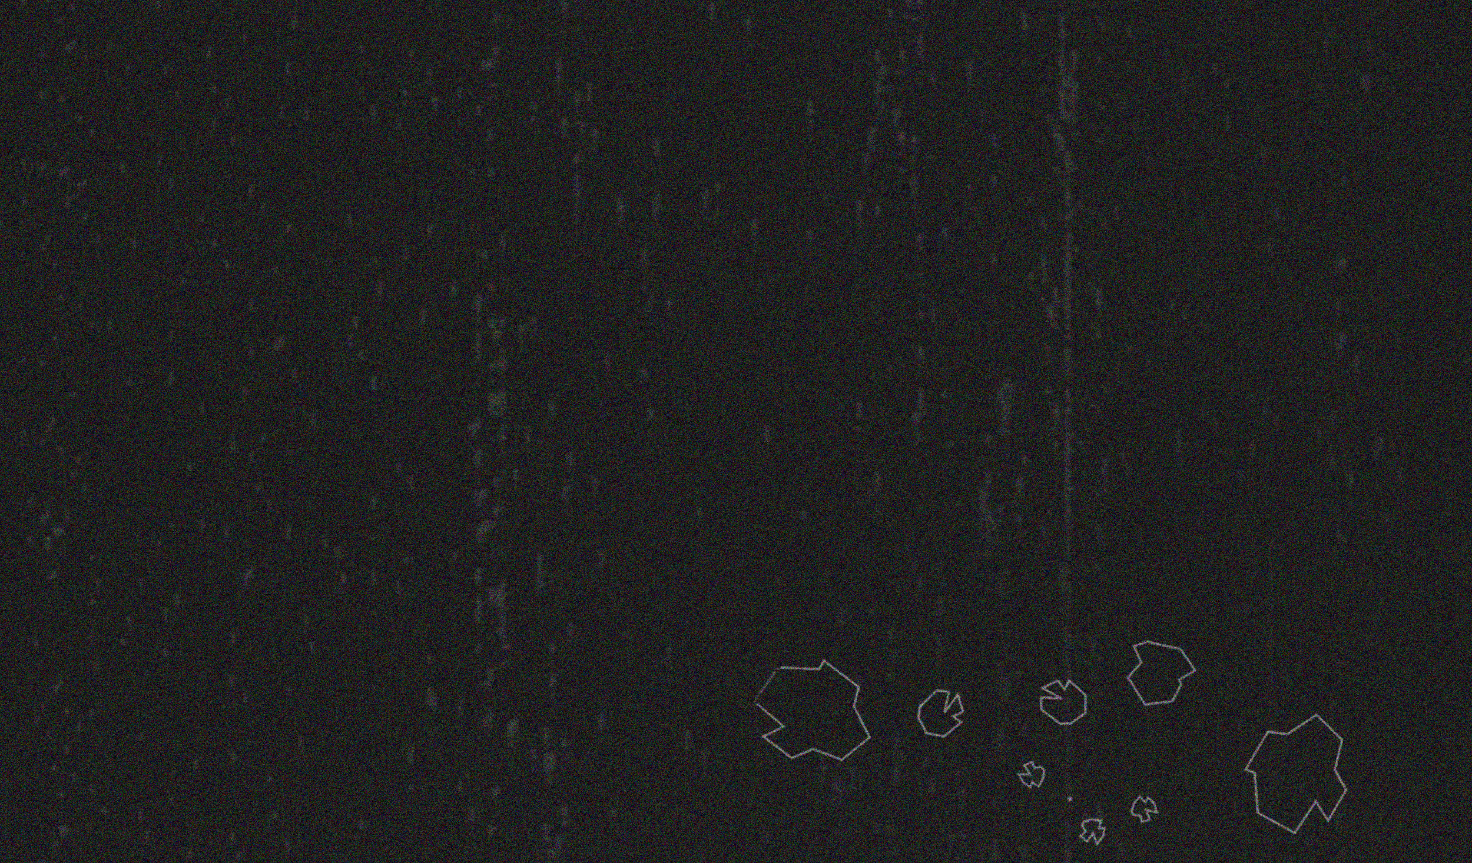
ENGI 301
Asteroids Game Proposal
10 / 2 / 20
Vi Vo

Slide 2
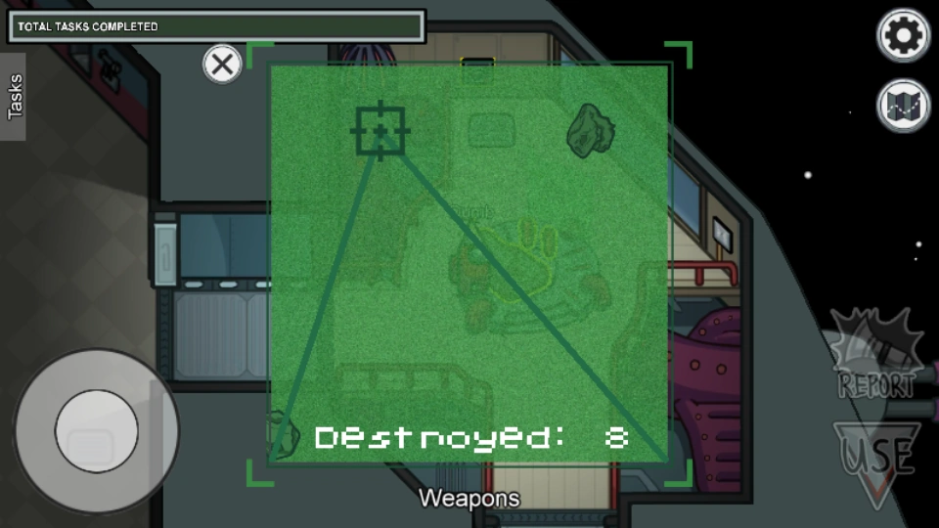
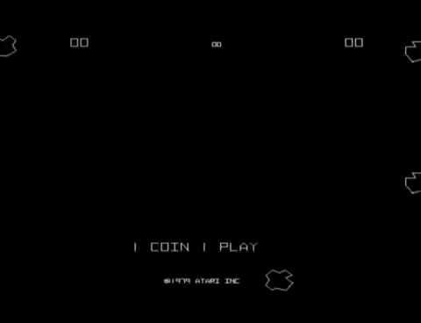
Background Information
In recent months, a social deduction game named “Among Us” has began to rise in popularity. The game involves crew members completing tasks on a spacecraft and finding out the imposter who wants to sabotage their mission and kill them. One of the tasks in the game called Clear Asteroids (similar to the arcade game counterpart) requires crew members to move the crosshair and shoot out 20 asteroids.
For my project, I want to propose a physical manifestation of Asteroids shoot with the same recognizable pew-pew sounds and general game mechanics!

Slide 3
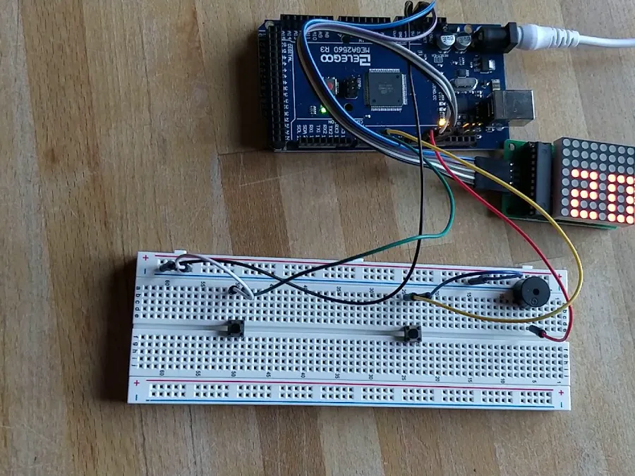
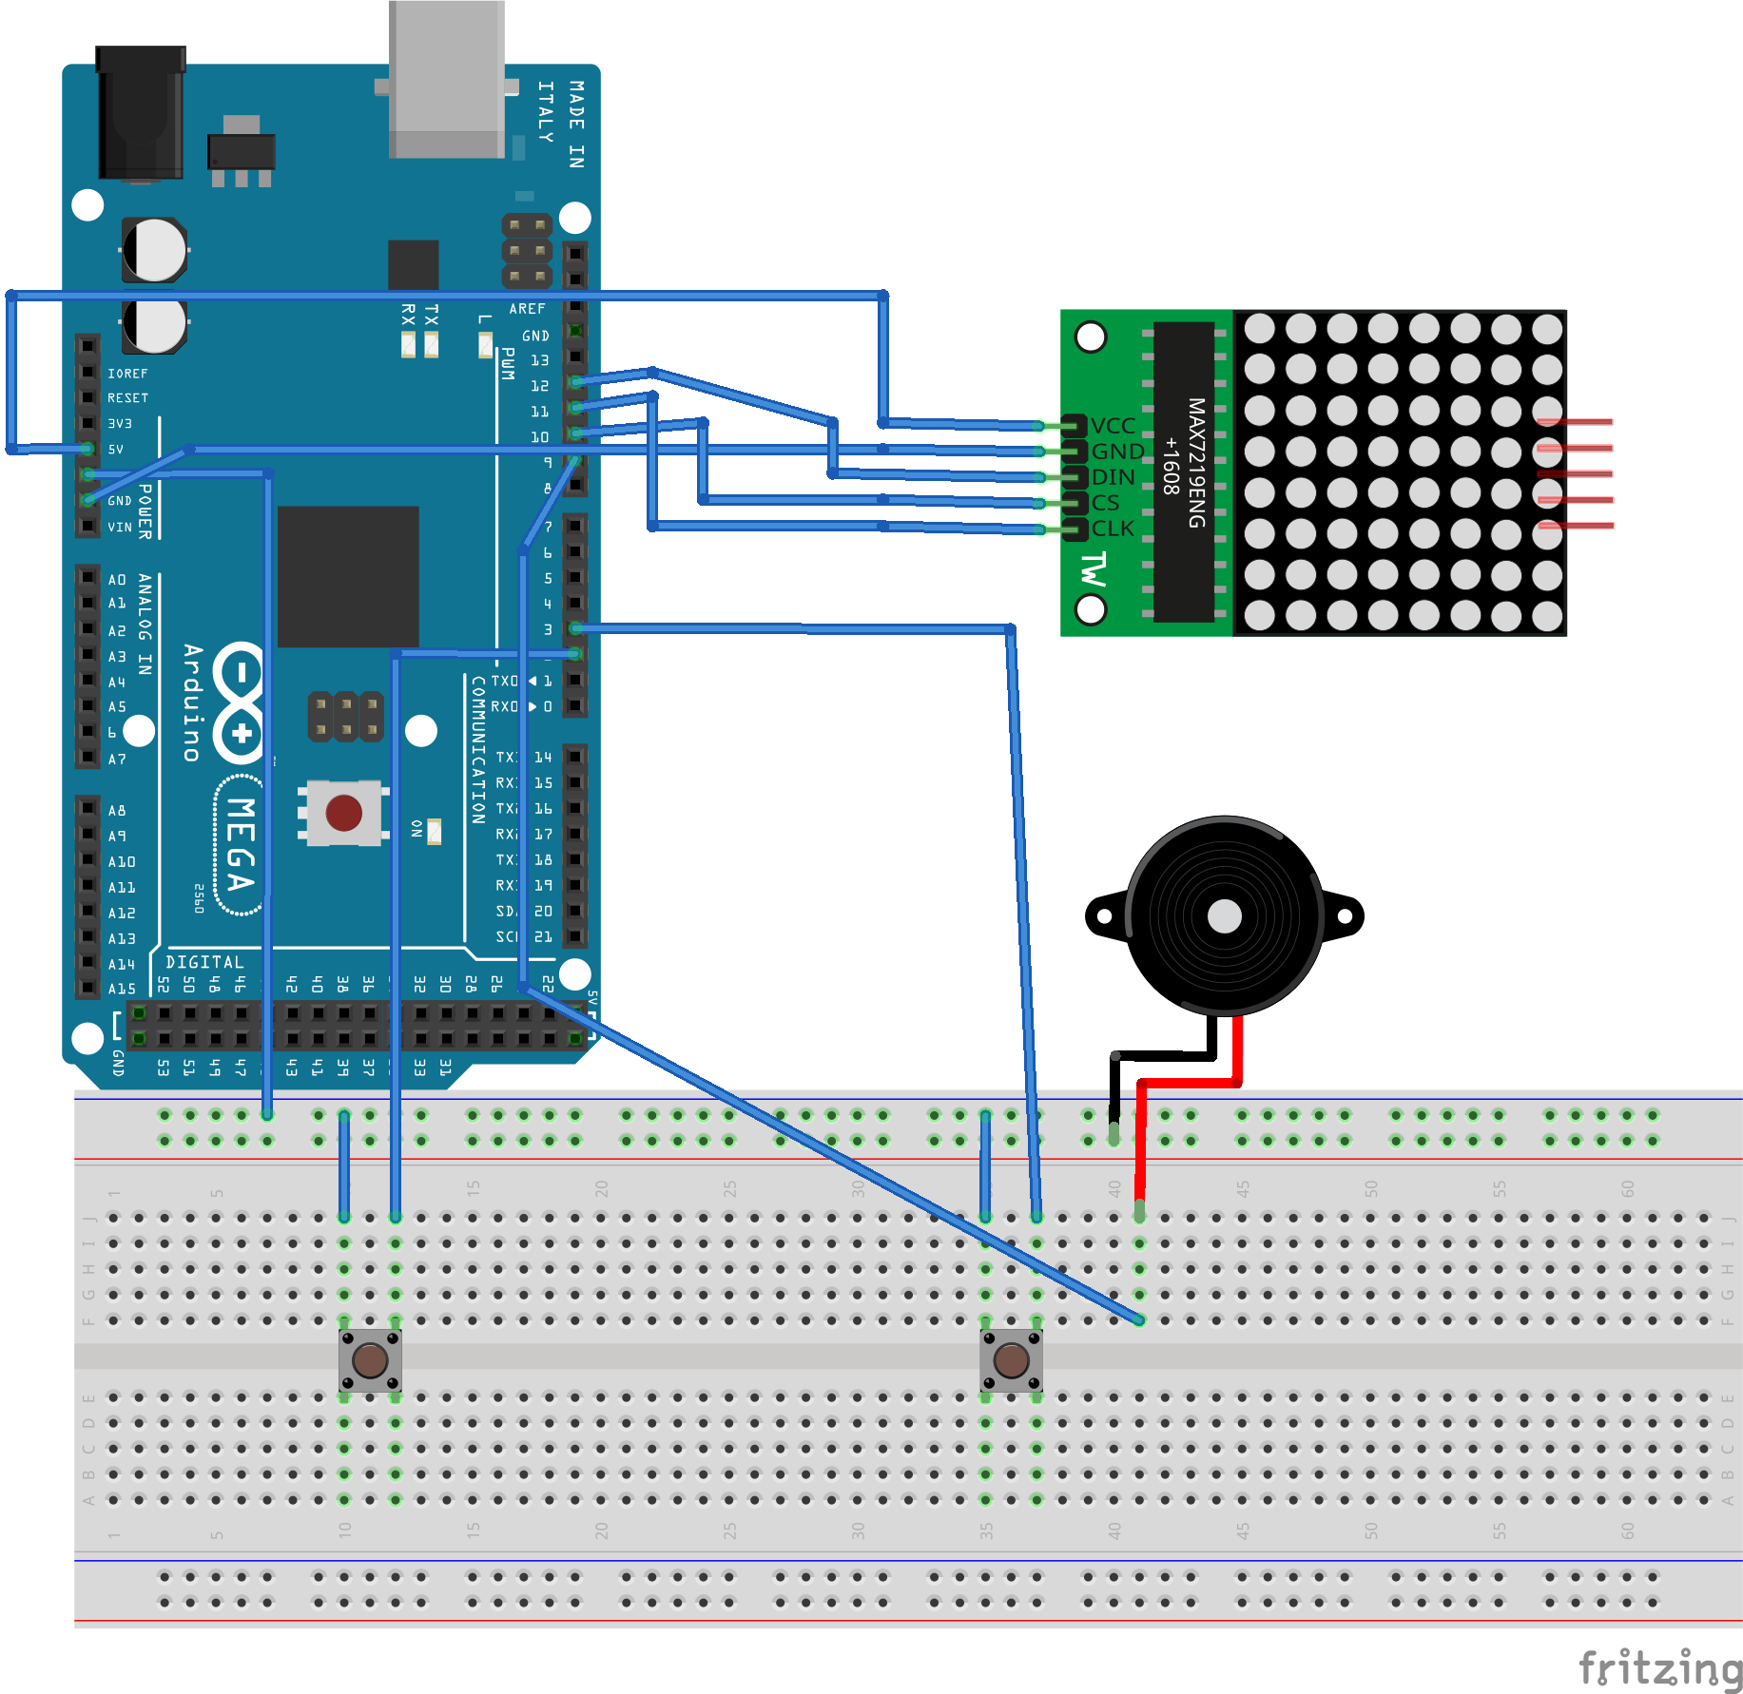
Background Information
Using the Asteroids game set-up as the base of the project (https://www.maximintegrated.com/en/design/reference-design-center/system-board/6251.html/tb_tab3) , a few modifications I will make:
Keep the pushbutton to shoot the asteroids. However, rather than pressing the button repeatedly to move the ship (or crosshair in this case), I will use a joystick module to add sensitivity/tilt control with the help of this library: https://github.com/MHeironimus/ArduinoJoystickLibrary
Create a new algorithm/code for the asteroids. Rather than dropping in a single column and one asteroid is one LED big, add variation to the asteroid size and randomize their movements. This also mean switching the 8x8 LED matrix for the 32x32 LED https://learn.adafruit.com/32x16-32x32-rgb-led-matrix/
The original asteroid game sets up score based on time. I will adjust so that it is base on the number of asteroids you clear and uses a hex display as a counter using the existing algorithm from lecture.
Adjust the frequency for the passive buzzer to include both clearing the asteroids and shooting the lazer. Modify library here: https://create.arduino.cc/projecthub/SURYATEJA/use-a-buzzer-module-piezo-speaker-using-arduino-uno-89df45

Slide 4
Systems Block Diagram
5V 2A Switching Supply
Joystick
Module
GND
+5V
PocketBeagle
+5V
GND
32x32
Adafruit RGB
LED Matrix Panel
GND
R1
G1
VR_{x}
VR_{y}
GND
B1
GND
SW
GPIO 111
GPIO,
59,58,57,
60, 52
R2
G2
3.3V
B2
GND
Vout
A
B
HT16K33 LED Controller
+
AIN 1.8 V,
1,2,3,4
C
D
SDA
-
CLK
LAT
D
SCL
OE
GND
C
AIN 1.8V, 0,7
PWM1
PWM0
PWM2
Passive
Buzzer
GND
V_{cc}
Notes:
Joystick - Needs +5V
HT16K33 -

Slide 5
Power Block Diagram
5V 2A Switching Supply
HT16K33 LED Controller
~3.3V Input (Supply Voltage up to ~6.5V)
Max 2mA (Rated for 5V input)
PocketBeagle
Uses 5V microUSB power input
3.3V
32x32 Adafruit RGB
LED Matrix Panel
~5V Required
Minimum of 4A
3.3V
5V
Joystick
Module
~5V Input
Vout
Level shifters/
translators
AIN 1.8V, 0
Analog Input reads current from Joystick
Passive
Buzzer
AC Input, ~0-5V Rated current <30mA
PWM0
Notes:
Joystick - Needs +5V
HT16K33 -

Slide 6
Components / Budget
Component | Need to Buy | Cost
Beagleboard.org Pocket Beagle | No | $28.50
Jumper Wires/Cables | No | $1.95
Resistors | No | $4.20
2 Generic Breadboards | No | $5.10
Adafruit 32x32 LED Matrix Panel | Yes | $34.95
PS2 Game Joystick Push Button Switch Sensor Module | No | $9.95
5V 2 Terminals Passive Buzzer | No | $5.99 (for 10)
Hex Display (HT16K33 LED Controller) | No | $9.95
Female DC Power Adapter | Yes | $2.00
5V Switching Supply | Yes | $7.95

